Slide 1

Music Generation and Sound Processing in a Functional Programming Paradigm
Giorgi Botkoveli
Cenikj Nikola
Abdin Hossameldin
Beka Grdzelishvili
Evan Sitt
Sylaj Tringa
Su Xiaotian
Szumi Xie
Viktória Zsók
Tsinadze Zurab

Slide 2
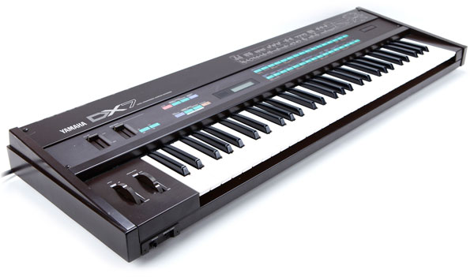
Digital Synthesis
First pioneered in 1957 with a punch card controlled analog synthesizer using 750 vacuum tubes.
Popularized in the music of the 1980’s by the Yamaha DX7
Extensively popular today across many disciplines.
Music
Telecommunications
Speech Translation

Slide 3
Additive Synthesis
Summation of input wave signals to create a new output signal.
Synthesizing a Fourier series by weighted summation of harmonics of the basic sine wave can generate all waves imaginable.
Limited only by processing power.
Resulting waveforms can be stored into waveform tables.

Slide 4
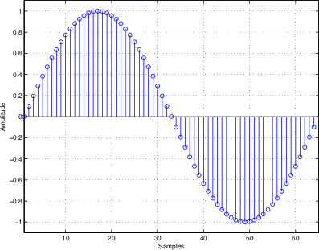
Wavetable Lookup Synthesis
Waveform values stored into a lookup table.
Typically a single period is stored.
Can store complex waveforms.
Ease of access based on frequency.
Faster and more efficient synthesis method.

Slide 5
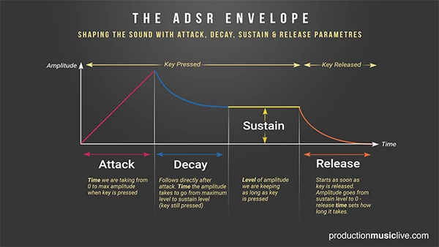
ADSR Envelope
Applies dampening/expansion to different stages of a sound.
Attack - Modifies sound from 0 to max amplitude from noteOn.
Decay - Modifies sound from max amplitude to Sustain level after Attack phase.
Sustain - Level of max amplitude to hold constant after Decay phase.
Release - Modifies sound from Sustain level to 0 after noteOff.
Drastically alters a sound’s character.
Can be extended to a DAHDSR Envelope.

Slide 6

MIDI
Stands for “Musical Instrument Digital Interface”
“Technical standard that describes a communications protocol, digital interface, and electrical connectors that connect a wide variety of electronic musical instruments, computers, and related audio devices for playing, editing and recording music.”
Contains detailed instructions that can be interpreted into musical notation.
Can further contain other detailed information for synthesizer standards such as General MIDI (GM)

Slide 7

Waveform Audio File Format
An audio file format standard, developed by Microsoft and IBM, for storing an audio bitstream on PCs.
Resource Interchange File Format (RIFF) bitstream format
Pulse Code Modulation (PCM) Encoding
Uncompressed, universally supported.

Slide 8
THANK YOU FOR YOUR ATTENTION!
This work was supported by the construction EFOP-3.6.3-VEKOP-16-2017-00002. The project was supported by the European Union, co-financed by the European Social Fund.

